Slide 1
Course 1 Final Project
Static Website
Kim Tae Jung
My Portfolio website

Slide 2
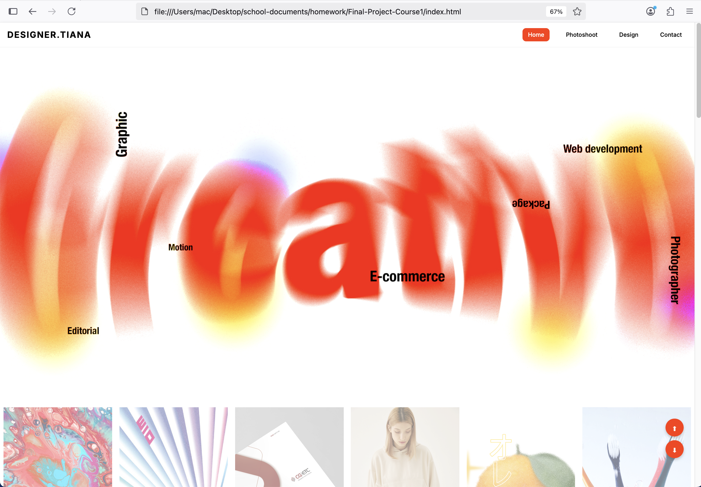
Static Website - Final Project
Your Name - Your Project’s Title
My Project
1 of 30: Showcase your Website
Open your website on a browser, and answer these questions:
What is your website about?
What pages and content does it have?
How do you navigate through your website?

Slide 3
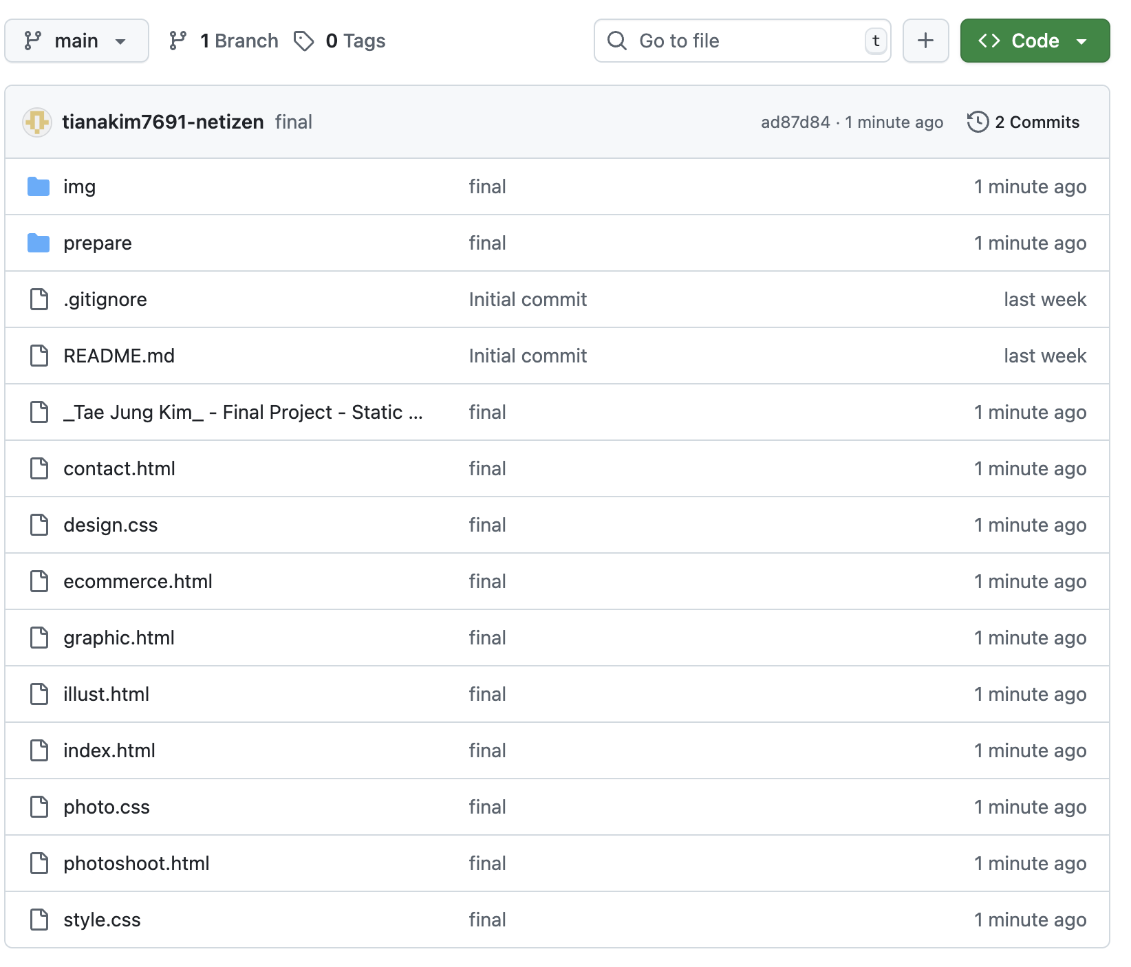
Static Website - Final Project
Your Name - Your Project’s Title
GitHub Repository
2 of 30: Share your GitHub repository
Answer these questions:
Is your project on GitHub?
How can a potential employer check it out? (clone)
<your GitHub repository link>

Slide 4
Static Website - Final Project
Your Name - Your Project’s Title
Project File Structure
3 of 30: Showcase how your Files are Organized
Answer these questions:
Do you have an index.html at the root?
If it isn’t at the root explain why.
Do you have other HTML pages? Where?
Do you have CSS files? Where?
Where/how do you organize your assets?
What other files do you have, if any?
Add one or more screenshot(s) of your project directories and files as they appear on VS Code explorer panel, and remove this frame and text.

Slide 5
Static Website - Final Project
Your Name - Your Project’s Title
README File
4 of 30: Showcase how you document with README file
Answer these questions:
Do you have a README.md file?
Where is it in the project structure?
What does it have?
Does it describe the project well?
Does it indicate who the author(s) and contributor(s) of the project are?
If necessary, does it include instructions for how to use or navigate your web project?
Is the README file formatted well?
Add one or more screenshot(s) of your project’s README file content, and remove this frame and text.

Slide 6
Static Website - Final Project
Your Name - Your Project’s Title
HTML5 Boilerplate
5 of 30: Showcase how you use HTML5 boilerplate
Answer these questions:
Does your html have:
DOCTYPE
lang attribute in <html>
charset metadata
viewport metadata
page title
Add one or more screenshot(s) of HTML5 boilerplate from any of your HTML files, and remove this frame and text.

Slide 7
Static Website - Final Project
Your Name - Your Project’s Title
Landing Page Navigation
6 of 30: Showcase landing page navigation
Answer these questions:
Which page is the one that browsers will load initially?
How do you handle navigation to other parts of the landing page, and/or to other pages in the website?
Add one or more screenshot(s) of the HTML (nav, menu, anchors) of your landing page navigation, and remove this frame and text.
Add screenshot of your landing page navigation menu as it appears on the browser, and remove this frame and text.

Slide 8
Static Website - Final Project
Your Name - Your Project’s Title
Multi-Page Navigation
7 of 30: Showcase navigation between pages
Answer these questions:
How do you handle navigation from other pages back to the home page?
How do you handle navigation between pages (back-and-forth) in general?
Add one or more screenshot(s) of the HTML (nav, menu, anchors) of other pages, and remove this frame and text.

Slide 9
Static Website - Final Project
Your Name - Your Project’s Title
General HTML Structure & Format
8 of 30: Showcase HTML structure
Answer these questions:
How are your HTML elements nested?
Do you have a <header> section?
If so, what is in it? If your <nav> is not in it explain why.
Do you have a <main> section?
If so, what is in it? If not, explain why.
Do you have other <sections>? Which?
Do you have a <footer>?
Do you have other section elements?
Ensure there are no noticeable issues with how your HTML is structured and formatted.
Add one or more screenshot(s) of the HTML *highlight how elements, especially sections, are nested
*highlight how indentation and white spaces are used,
and remove this frame and text.

Slide 10
Static Website - Final Project
Your Name - Your Project’s Title
HTML Comments
9 of 30: Showcase use of HTML comments
Answer these questions:
Did you use comment lines in your HTML?
Give some examples of where, how and why.
Add one or more screenshot(s) of HTML comments *highlight how you use HTML comments,
and remove this frame and text.

Slide 11
Static Website - Final Project
Your Name - Your Project’s Title
Inline CSS
10 of 30: Showcase inline CSS
Answer these questions:
Can you show one example of inline styling?
Add one or more screenshot(s) of
inline CSS in your project,
and remove this frame and text.

Slide 12
Static Website - Final Project
Your Name - Your Project’s Title
Internal CSS
11 of 30: Showcase internal CSS
Answer these questions:
Can you show one example of internal styling?
Add one or more screenshot(s) of
internal CSS in your project, *make sure to show the <style> elements and where they are placed in the project,
and remove this frame and text.

Slide 13
Static Website - Final Project
Your Name - Your Project’s Title
External CSS
12 of 30: Showcase external CSS
Answer these questions:
Did you use external styling in your project?
Add a screenshot of the external CSS being added via a <link> element in one of your HTML pages,
and remove this frame and text.
Add a screenshot of your CSS file in the VS Code explorer panel, and remove this frame and text.

Slide 14
Static Website - Final Project
Your Name - Your Project’s Title
CSS Block Display
13 of 30: Showcase block elements
Answer these questions:
What is an example of an element with block display in your project?
Note: Many elements have display block by default, so you do not need to explicitly give it in your CSS. Simply indicate an element in your project that has block display and why.
Add a screenshot of the element
as it appears on the website in the browser,
and remove this frame and text.
Add a screenshot of the CSS of the element, and remove this frame and text.

Slide 15
Static Website - Final Project
Your Name - Your Project’s Title
CSS Inline Display
14 of 30: Showcase inline elements
Answer these questions:
What is an example of an element with inline display in your project?
Note: Many elements have display inline by default, so you do not need to explicitly give it in your CSS. Simply indicate an element in your project that has inline display and why.
Add a screenshot of the element
as it appears on the website in the browser,
and remove this frame and text.
Add a screenshot of the CSS of the element, and remove this frame and text.

Slide 16
Static Website - Final Project
Your Name - Your Project’s Title
CSS Inline-Block Display
15 of 30: Showcase inline-block elements
Answer these questions:
What is an example of an element with inline-block display in your project?
Why does that element have inline-block display?
Add a screenshot of the element
as it appears on the website in the browser,
and remove this frame and text.
Add a screenshot of the CSS of the element, and remove this frame and text.

Slide 17
Static Website - Final Project
Your Name - Your Project’s Title
CSS Type Selector
16 of 30: Showcase CSS type selector
Answer these questions:
What is an example of a type selector in the CSS of your project?
Add a screenshot of the element
as it appears on the website in the browser,
and remove this frame and text.
Add a screenshot of the CSS type selector declaration, and remove this frame and text.

Slide 18
Static Website - Final Project
Your Name - Your Project’s Title
CSS Class Selector
17 of 30: Showcase CSS class selector
Answer these questions:
What is an example of a class selector in the CSS of your project?
Add a screenshot of the element
as it appears on the website in the browser,
and remove this frame and text.
Add a screenshot of the CSS class selector declaration, and remove this frame and text.

Slide 19
Static Website - Final Project
Your Name - Your Project’s Title
CSS Id Selector
18 of 30: Showcase CSS id selector
Answer these questions:
What is an example of an id selector in the CSS of your project?
Add a screenshot of the element
as it appears on the website in the browser,
and remove this frame and text.
Add a screenshot of the CSS id selector declaration, and remove this frame and text.

Slide 20
Static Website - Final Project
Your Name - Your Project’s Title
CSS Box Model
19 of 30: Showcase CSS Box Model
Answer these questions:
Can you showcase how you utilize the Box Model for styling elements?
Did you use the box-sizing property?
Does the element have margin?
Does the element have border?
Does the element have padding?
Does the element have width, height, or content?
Add a screenshot of the element’s box model values as shown in the Google Chrome or Firefox developer tools style inspector panel,
and remove this frame and text.
Add a screenshot of the CSS, and remove this frame and text.

Slide 21
Static Website - Final Project
Your Name - Your Project’s Title
CSS Basic Properties
20 of 30: Showcase basic CSS properties
Answer these questions:
Did you use background properties?
Did you use color properties?
Did you use font and text properties?
Add a screenshot of the element
as it appears on the website in the browser,
and remove this frame and text.
Add a screenshot of the CSS, and remove this frame and text.

Slide 22
Static Website - Final Project
Your Name - Your Project’s Title
CSS Pseudo-classes
& Link Styles
21 of 30: Showcase pseudo-classes with link styles
Answer these questions:
Did you use pseudo-classes in your project?
Showcase an example of :link
Showcase an example of :visited
Showcase an example of :hover
Showcase an example of :active or :focus
Did you follow the LVHA order for link styling?
Add screenshots of the links as they appear on the web page in the browser in their various states,
and remove this frame and text.
Add a screenshot of the CSS, and remove this frame and text.

Slide 23
Static Website - Final Project
Your Name - Your Project’s Title
CSS Float
22 of 30: Showcase Floated Element
Answer these questions:
Can you showcase an example of a Floated element?
Is it floated left or right? Why?
Add a screenshot of the floated element
as it appears on the website in the browser,
and remove this frame and text.
Add a screenshot of the CSS, and remove this frame and text.

Slide 24
Static Website - Final Project
Your Name - Your Project’s Title
CSS Clear Property
23 of 30: Showcase Clear Property
Answer these questions:
Can you showcase an example of the clear property?
What elements are being cleared, and why?
Add a screenshot of the cleared elements
as they appear on the website in the browser,
and remove this frame and text.
Add a screenshot of the CSS, and remove this frame and text.

Slide 25
Static Website - Final Project
Your Name - Your Project’s Title
CSS Flexbox Container
24 of 30: Showcase a Flexbox Container
Answer these questions:
Can you showcase an example of an element with a display of Flex?
Did you use the justify-content property?
Did you use the align-items property?
Did you use the flex-wrap property?
Did you use the flex-direction property?
Did you use the gap property?
Did you use any other properties in the flex container? Which and why?
Add a screenshot of the flexbox element
as it appears on the website in the browser,
and remove this frame and text.
Add a screenshot of the CSS, and remove this frame and text.

Slide 26
Static Website - Final Project
Your Name - Your Project’s Title
CSS Flexbox Items
25 of 30: Showcase Flexbox Items
Answer these questions:
Can you showcase an example of two or more elements that are contained in a flexbox?
Did you use the flex properties?
Did you use the align-self property?
Did you use the order property?
Add a screenshot of the flexbox items
as they appear on the website in the browser,
and remove this frame and text.
Add a screenshot of the CSS, and remove this frame and text.

Slide 27
Static Website - Final Project
Your Name - Your Project’s Title
CSS Grid
26 of 30: Showcase CSS Grid
Answer these questions:
Can you showcase an example of an element with a display of grid?
Did you use grid-template-columns?
Did you use grid-template-rows?
Did you use grid areas? Named or unnamed?
Did you use gap property?
Did you use any other grid properties?
Add a screenshot of the grid
as it appears on the website in the browser,
and remove this frame and text.
Add a screenshot of the CSS, and remove this frame and text.

Slide 28
Static Website - Final Project
Your Name - Your Project’s Title
CSS Overflow Property
27 of 30: Showcase use of Overflow
Answer these questions:
Can you showcase an example of the overflow property?
Add a screenshot of the element with adjusted overflow
as it appears on the website in the browser,
and remove this frame and text.
Add a screenshot of the CSS, and remove this frame and text.

Slide 29
Static Website - Final Project
Your Name - Your Project’s Title
CSS Syntax & Formatting
28 of 30: Showcase CSS Syntax & Format
Answer these questions:
Does your CSS have proper indentation and white space usage?
Are your CSS declarations organized in a good order without specificity conflicts?
Add one or more screenshot(s) of your CSS code,
and remove this frame and text.

Slide 30
Static Website - Final Project
Your Name - Your Project’s Title
CSS Comments
29 of 30: Showcase CSS Comments
Answer these questions:
Did you use comment lines in your CSS?
Give some examples of where, how and why.
Add one or more screenshot(s) of CSS comments *highlight how you use CSS comments,
and remove this frame and text.

Slide 31
Static Website - Final Project
Your Name - Your Project’s Title
Biggest Challenge
30 of 30: Showcase your Biggest Challenge
Answer these questions:
What was your biggest challenge or struggle with the project so far?
If you overcame it, how did you do it?
Add one or more screenshot(s), and remove this frame and text.

